Slide 1
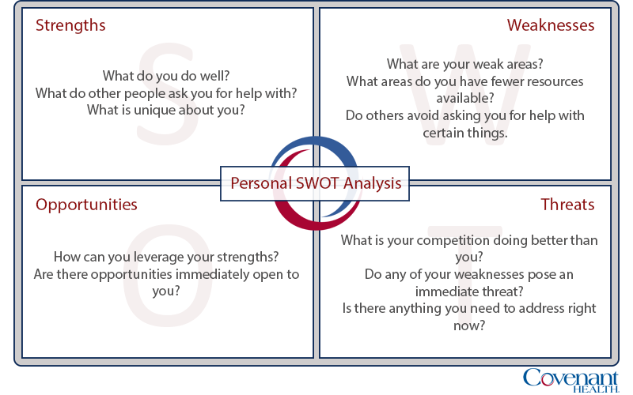

Slide 2
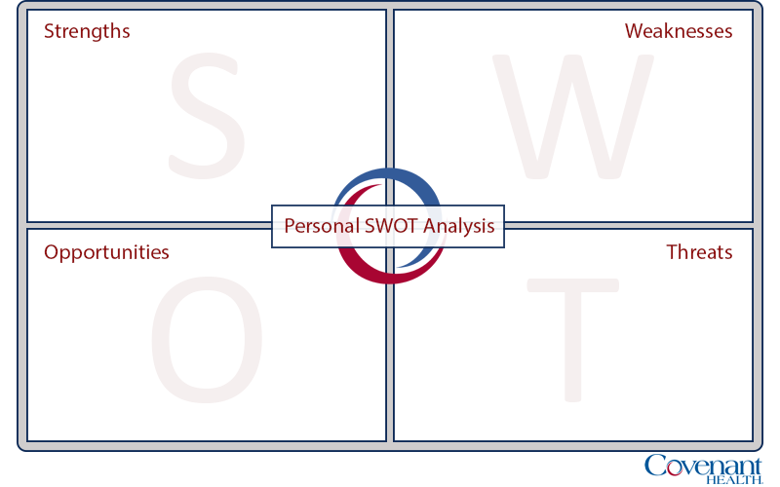
Enter your strengths.
Enter your weaknesses.
Enter your opportunities.
Enter your threats.

