Slide 1
monday - friday
breakfast | 6:30 am – 9:00 am
lunch | 11:00 am – 2:00 pm
saturday & sunday
lunch | 11:00 am – 2:00 pm

Slide 2
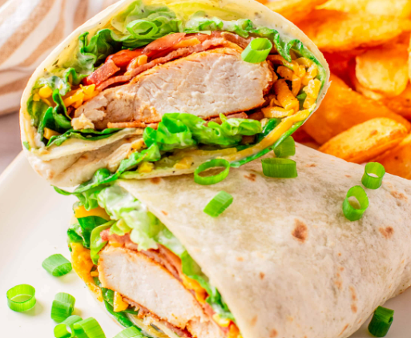
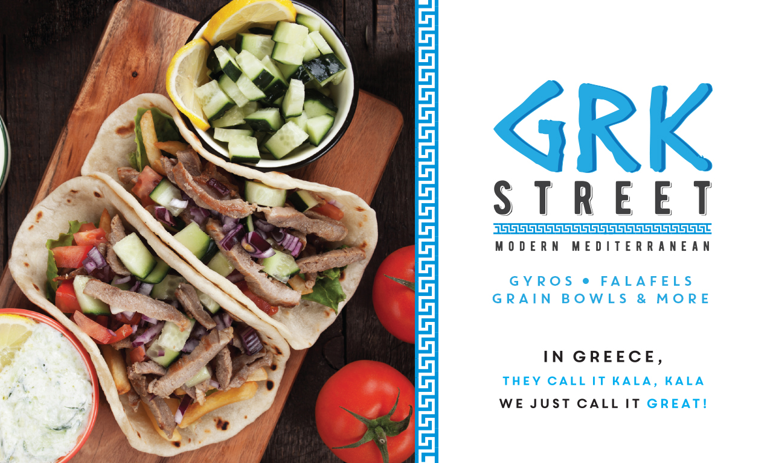
 | Monday 8/28 | Tuesday 8/29 | Wednesday 8/30 | Thursday 8/31 | Friday 9/1
Breakfast Special | Bacon Egg and Cheese Brioche | Ham Egg and Cheese Croissant | English Muffin Bacon Egg and Cheddar | Crispy Chicken Egg and Cheese Biscuit | Sausage Egg and on Brioche
Pop Up/ LTOs | Chicken Wraps with Fried Kraft Mac and Cheese | Chicken Wraps with Fried Kraft Mac and Cheese | Grk Street | Grk Street | Closed
Entrée Reimagined | Tavola | Verde | Kazan | Creole Queen | Okra
 | Penne Pasta or Cheese Tortellini w/ Alfredo or Marinara | Burrito Bar | Fried Rice | Blackened Pollock or Cajun Fried Catfish | Meatloaf or Smothered Pork Chops
 | Turkey Meatballs | Fajita Chicken or Beef Taco Meat | Chicken Teriyaki | Cajun Red Beans Rice or Andouille Sausage and Potato Hash | Hash Brown Casserole
 | Breaded Eggplant Parmesan | Black Beans and Spanish Rice | Honey Walnut Shrimp | Fried Okra | Ranch Creamed Spinach
 | Garlic Spinach | Assorted Toppings | Egg rolls | Collard Greens | Smashed Red Potatoes
 | Garlic Roasted Broccoli | Green or Red Salsa | Ginger Sauce | Cajun Cabbage Slaw | Corn Feta and Tomato Salad
 | Balsamic Roasted Brussel Sprouts | Guacamole | Yum Yum sauce | Hush Puppies | Vidalia Onion honey Mustard Sauce
Soup | Closed for Summer | Closed For Summer | Closed for Summer | Closed for Summer | Closed for Summer

